Slide 1
Save a Life 101
CPR, Stop the Bleed, First Aid, and more!

Slide 2
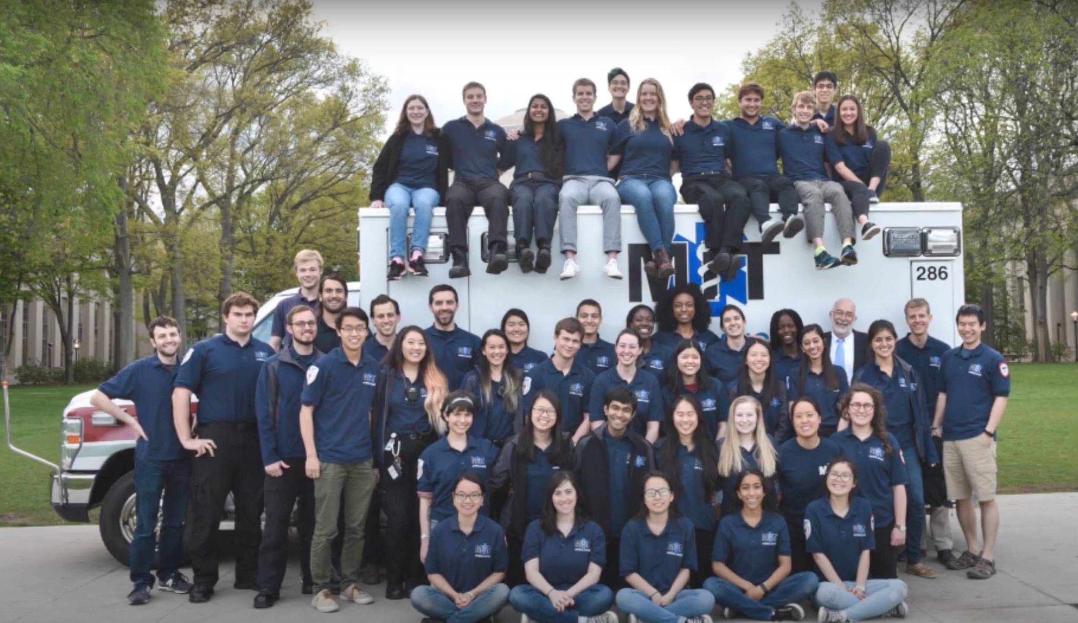
ABOUT US
You could enter a subtitle here if you need it

Slide 3
AGENDA
1
2
3
4
CPR
Stop the Bleed
Save lives in a cardiac emergency
Save lives when someone is severely bleeding
Strokes
Life as an EMT
How to recognize a stroke and what to do
Hear about some of our experiences as EMTs

Slide 4
Cardiopulmonary Resuscitation (CPR)
** Note: this is not a CPR certification class, we’re just here to inform!

Slide 5
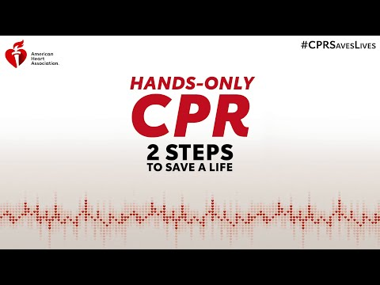
Notes:
https://www.youtube.com/watch?v=M4ACYp75mjU

Slide 6
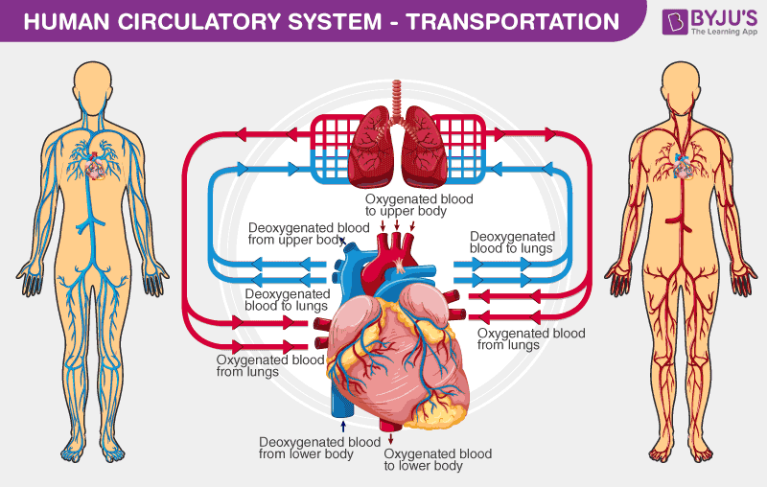
The Circulatory System

Slide 7
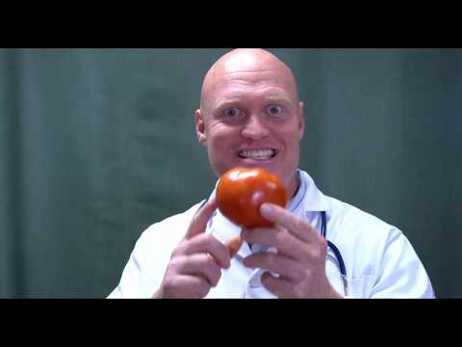
Notes:
https://www.youtube.com/watch?v=4u69rGzWmcQ

Slide 8
How to: Hands Only CPR
Check for responsiveness and breathing
Call for help
Push hard and fast in the center of the chest (100-120 bpm)
Compress at least 2 inches but let the chest completely rise between compressions
Follow the instructions of the AED once it arrives

Slide 9
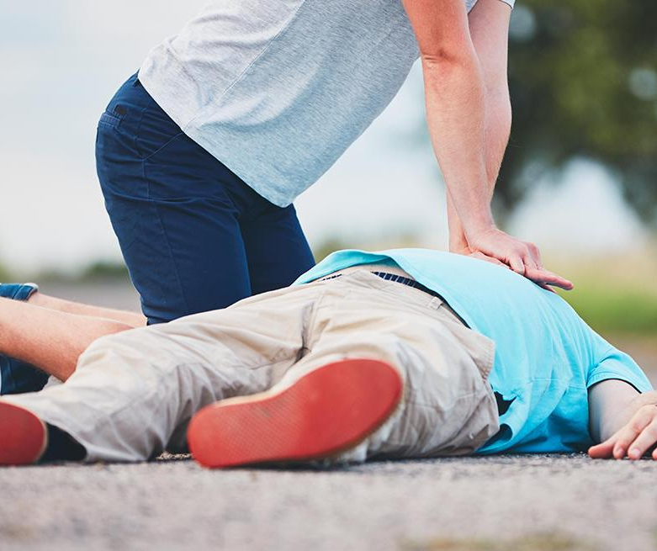
Use the people around you
Designate people to do have specific roles
  Call 911
  Grab an AED
Call them by name or identifier
Tell them their specific responsibility
Make sure you see a nod of agreement

Slide 10
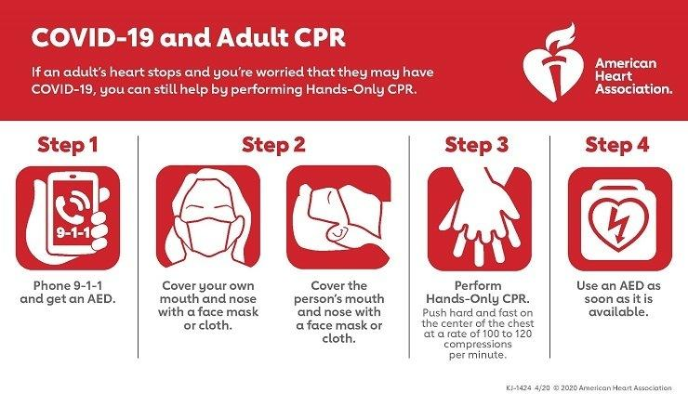
CPR and COVID-19

Slide 11
Stop the Bleed
** Note: this is also not a certification class!
Notes:
Why it’s important:
#1 cause of preventable death after injury is bleeding
Must be stopped as soon as possible
Where/what situation might you have to use the skills to stop serious bleeding?
Many injury mechanisms (everyday injuries such as those at home/work/road, mass shooting)
Ex. sporting event, broken glass

Slide 12
Goals
Identify
  Recognize life-threatening bleeding
Stop the Bleed
  Pressure
  Packing
  Tourniquets
Notes:
Mention personal safety maybe
Help others only when it’s safe to do so
In unsafe situations: stop, move to safety, take victim with you if you can
Wear gloves if you can, clean any blood that gets on you (and tell health care provider)

Slide 13
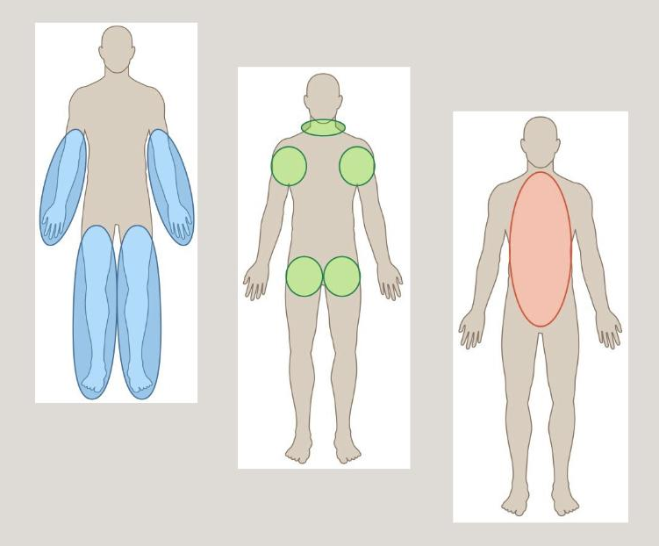
ABCs of Bleeding Control
A Alert 911
B Bleeding
C Compress
Notes:
Alert for help
Looking for continuous and/or large volumes of bleeding
Apply direct pressure with gauze, pack the wound with gauze, or use a tourniquet until help arrives

Slide 14

Compress - Pressure
Notes:
https://www.youtube.com/watch?v=aNCiHPuhsWE
Apply direct pressure to wound
Focus on the location of the bleeding
Use just enough gauze or cloth to cover injury
If pressure stops the bleeding, keep pressure on wound until help arrives
Keep that pressure (may require significant amount of force)

Slide 15
Compress - Packing
Notes:
https://www.youtube.com/watch?v=Nd5GKlbacT0
For large wounds, where pressure is not enough
if bleeding is from a deep wound, pack gauze tightly into wound
Careful for sharp objects or fragments of bone within cavity
Once bleeding stops, hold pressure until help arrives

Slide 16
Compress - Tourniquet
Notes:
https://www.youtube.com/watch?v=Ibhv5DK9U9U
Apply 2-3 inches above wound
Do not place over elbow or knee
Tighten tourniquet until bleeding stops
Do NOT remove the tourniquet
You can apply this to yourself or others, can be applied over clothes,
Tourniquets HURT
A second tourniquet may be required

Slide 17
Strokes

Slide 18
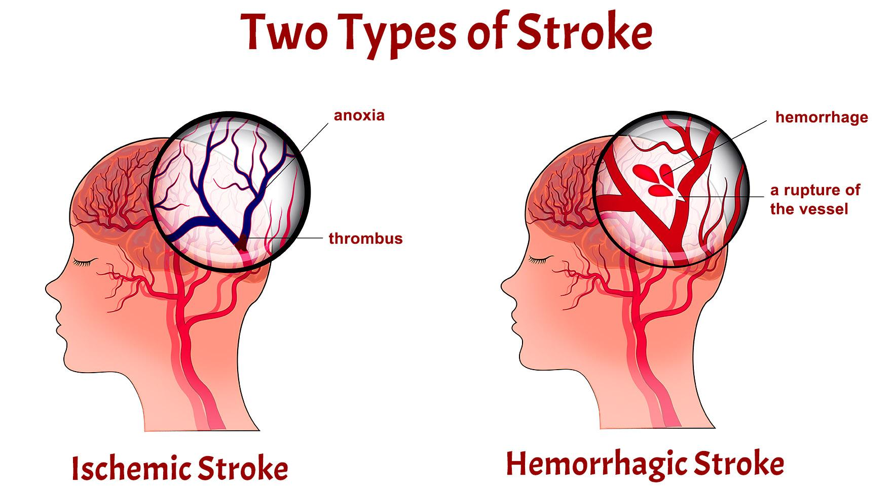
What is a stroke?

Slide 19
Stroke FAST Acronym
F
A
S
T
Facial Droop
Arm Weakness
Speech Difficulty
Time

Slide 20
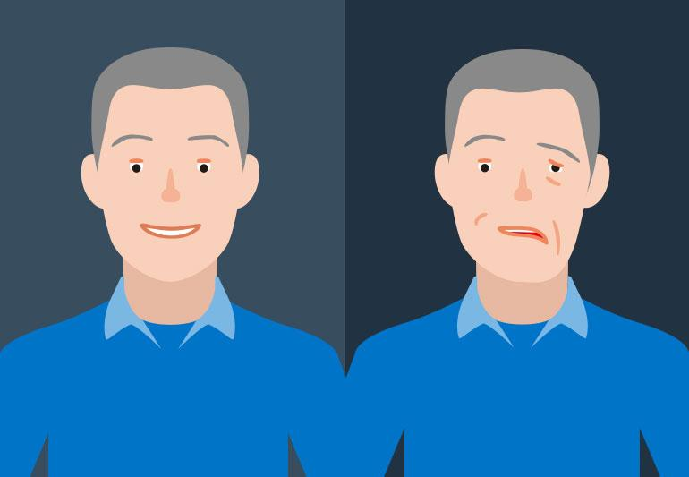
F

Slide 21
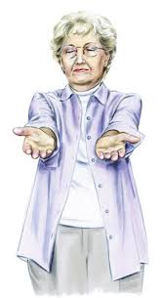
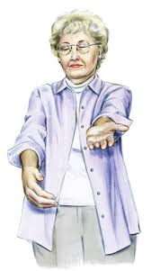
A

Slide 22
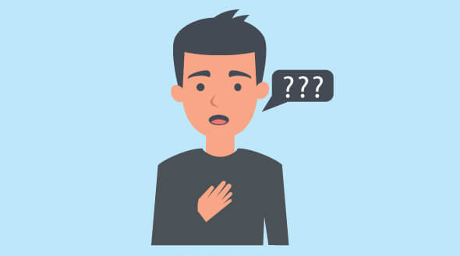
S

Slide 23
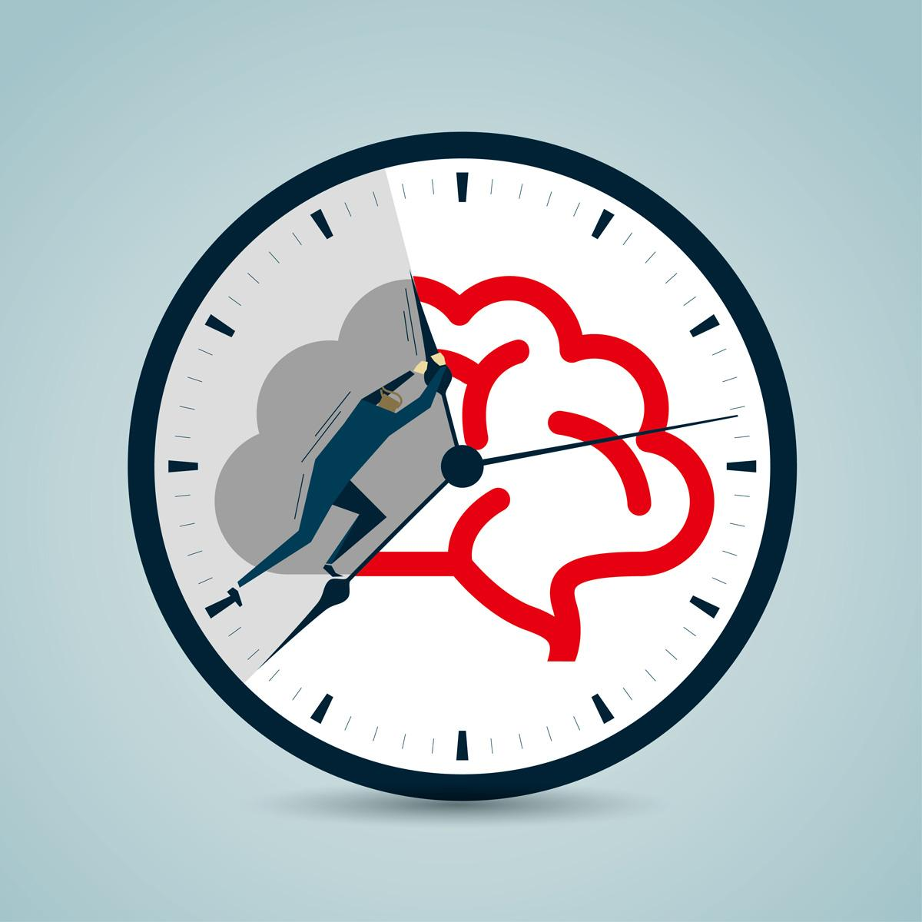
T

Slide 24
Life as an EMT

Slide 25
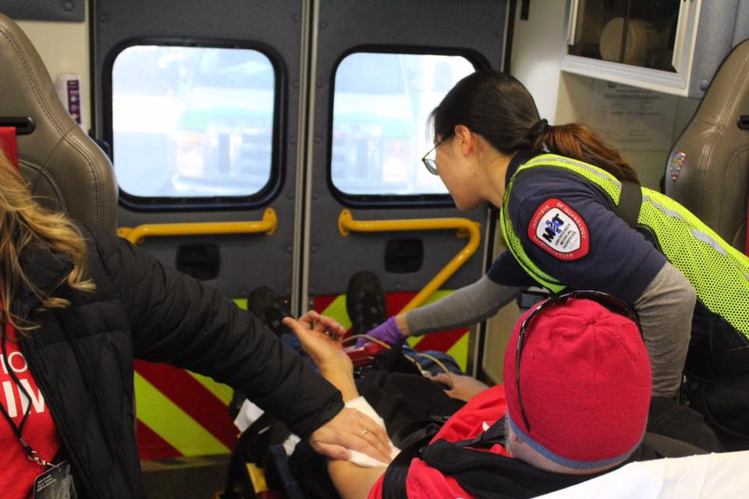
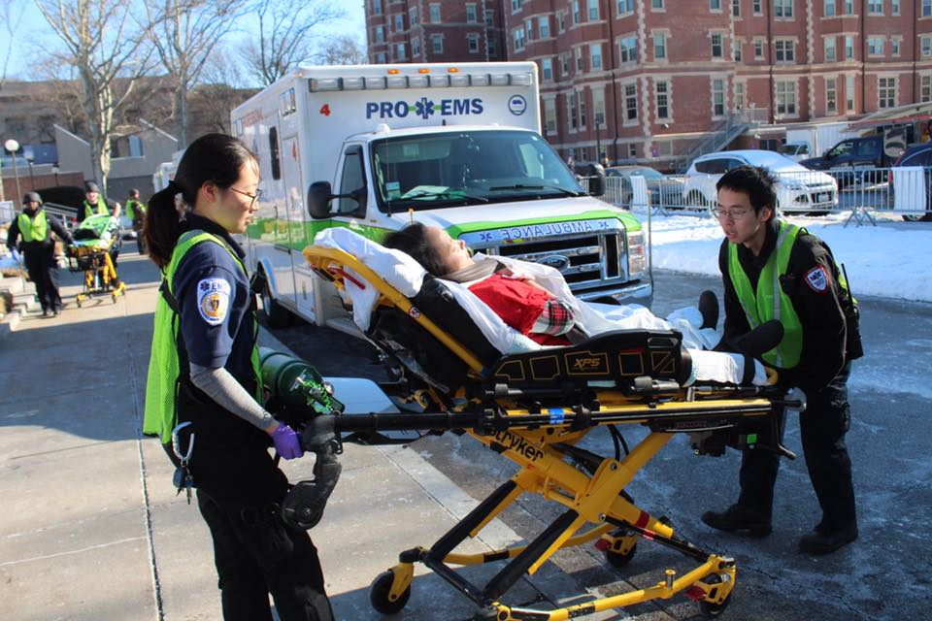
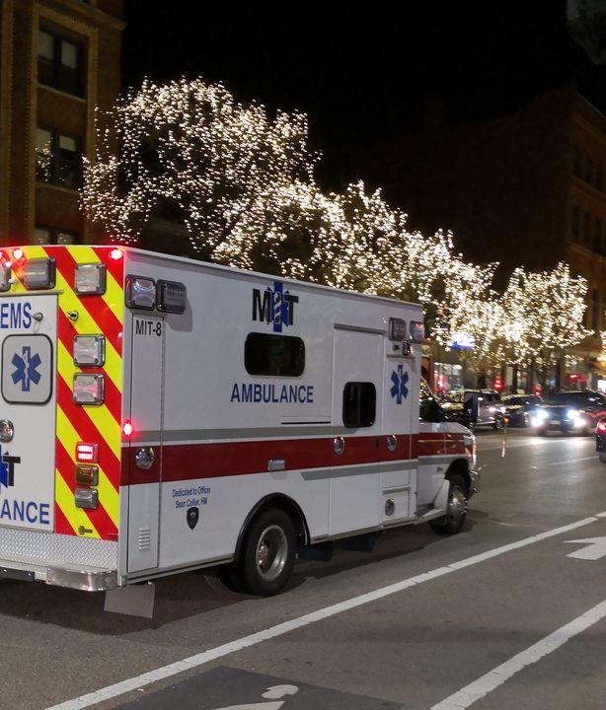
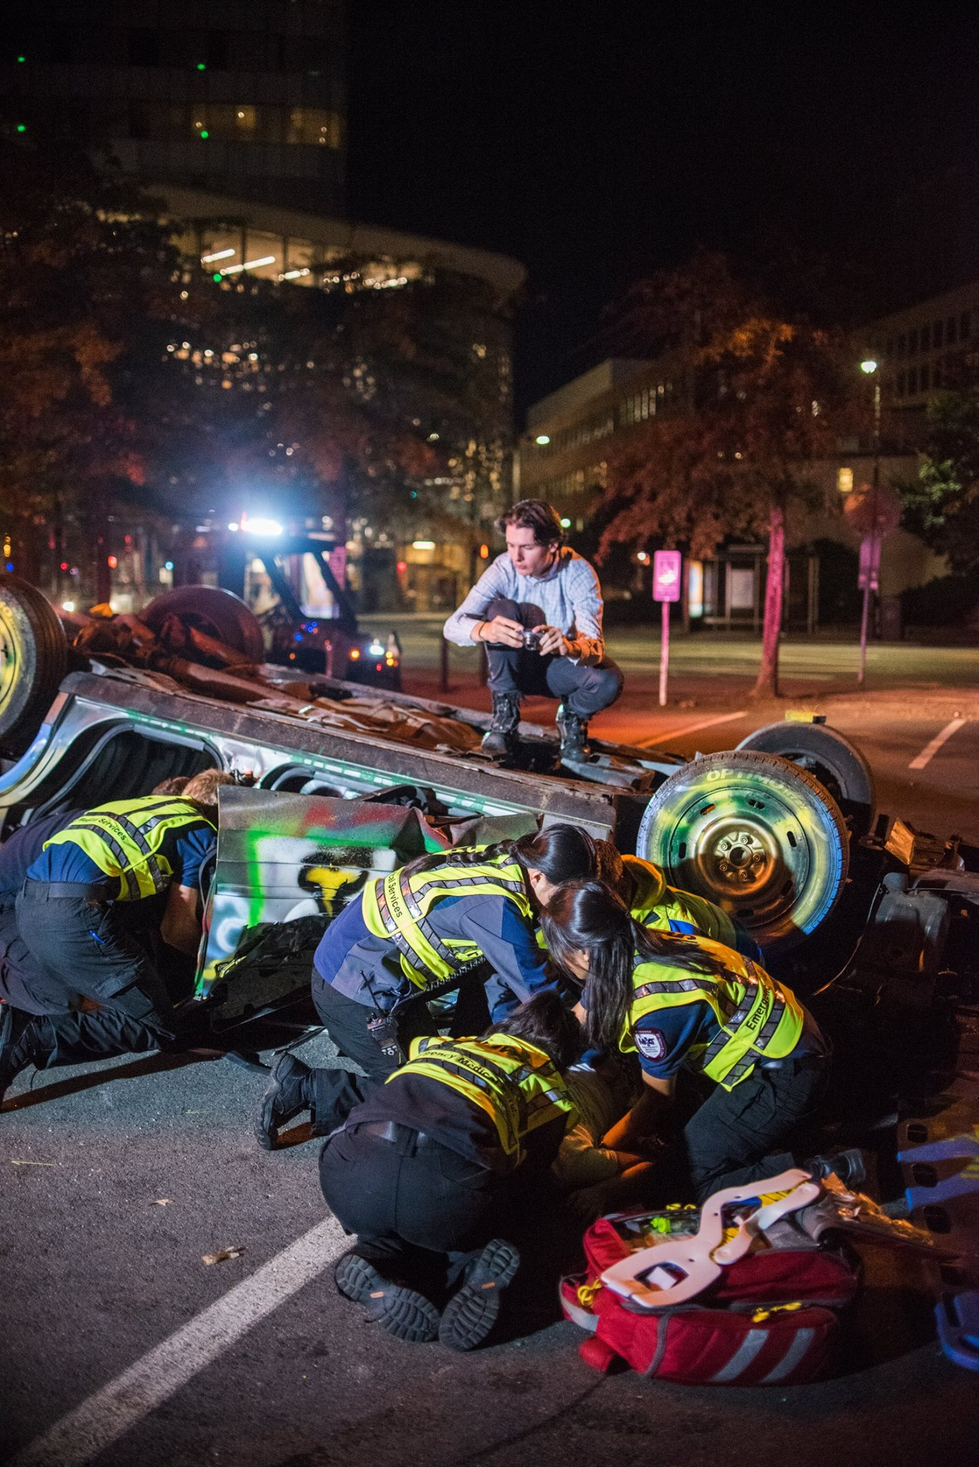
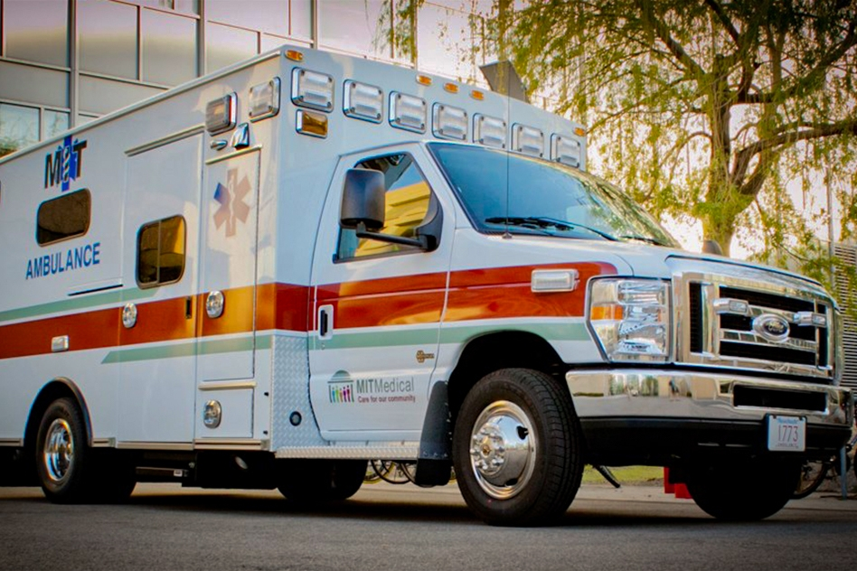
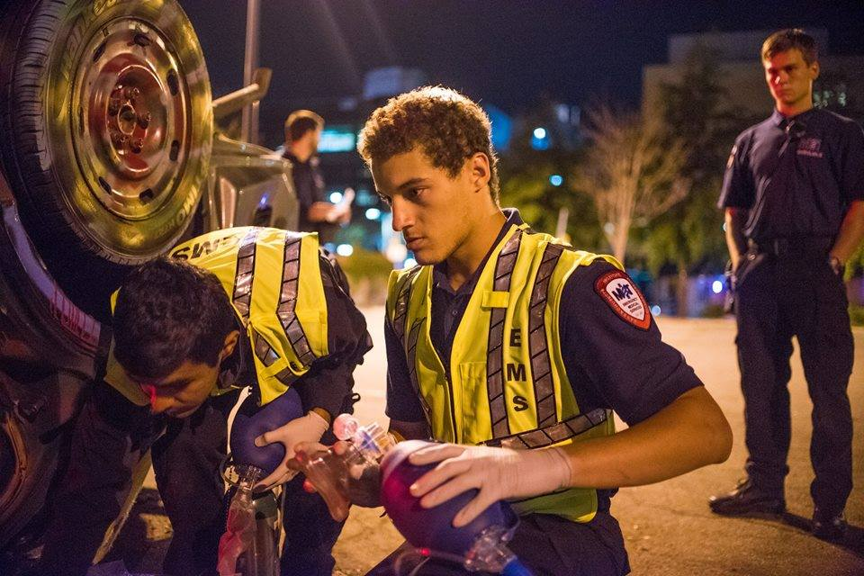

Slide 26
Trivia

Slide 27


